Slide 1
Homework-02
Ushaswini
800983632

Slide 2
Introduction
This app downloads the list from url - http://dev.theappsdr.com/apis/summer_2016_ios/data.json and displays the items of list in a UITableView
List of items is divided into two sections – “Applications” and “Books”
There are three different types of cells
Cell with no other image and no summary
Cell with no other image but with summary
Cell with other image but no summary
This app uses CocoaPods to manage dependencies on third party libraries

Slide 3
Design and Implementation
Three types of prototype cells are created for each cell-type
Alamofire is used to perform networking tasks
SDWebImage is used to download images into image view
Auto-layout is used to scale user interface for multiple screens

Slide 4
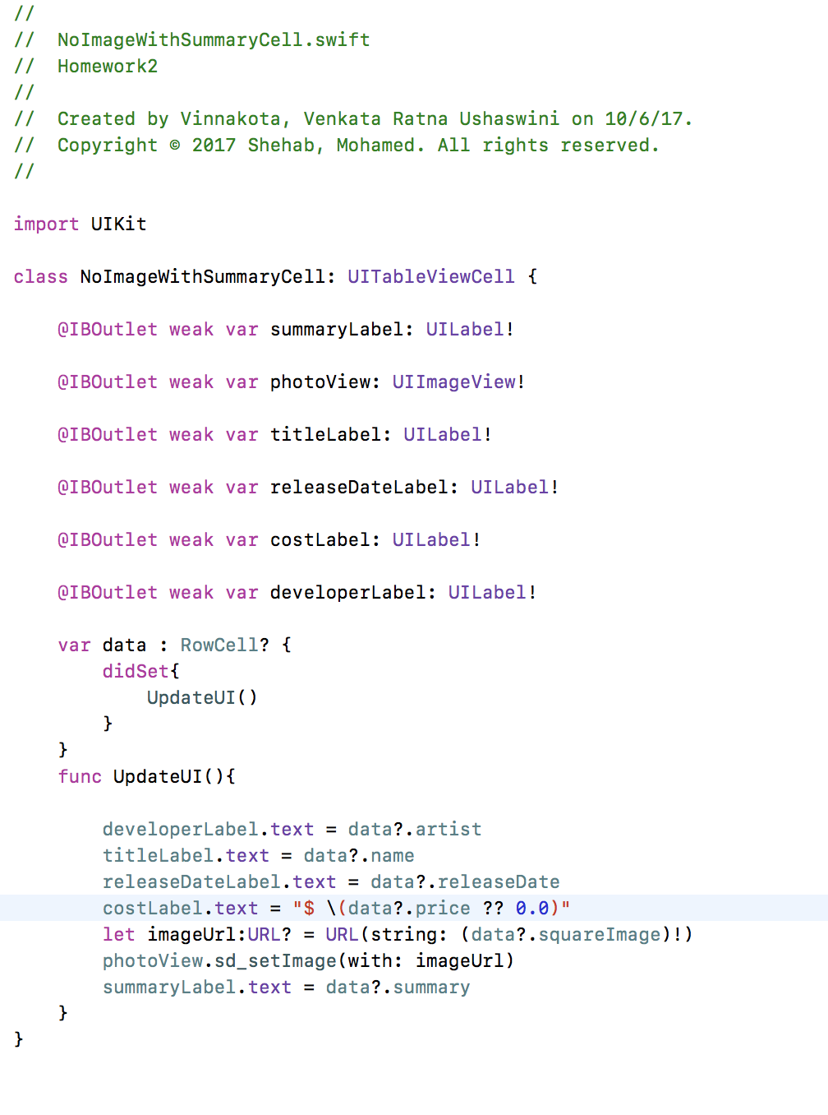
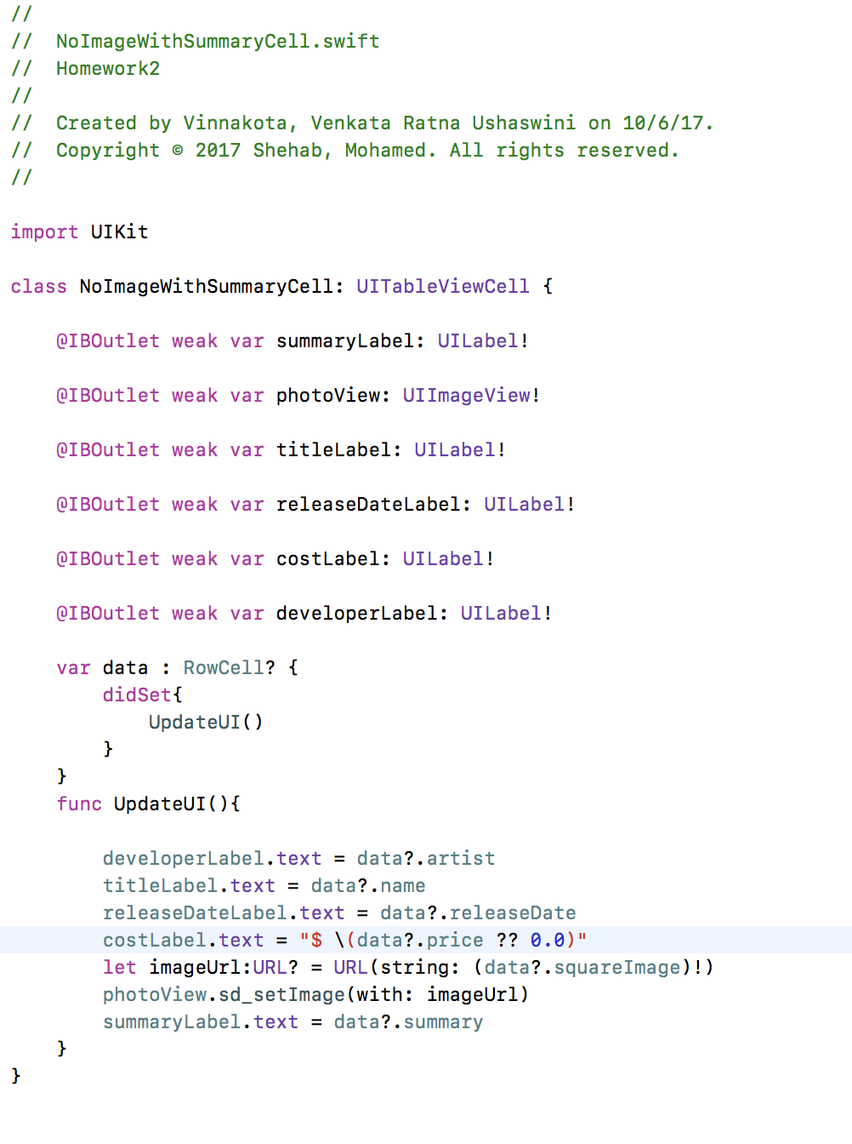
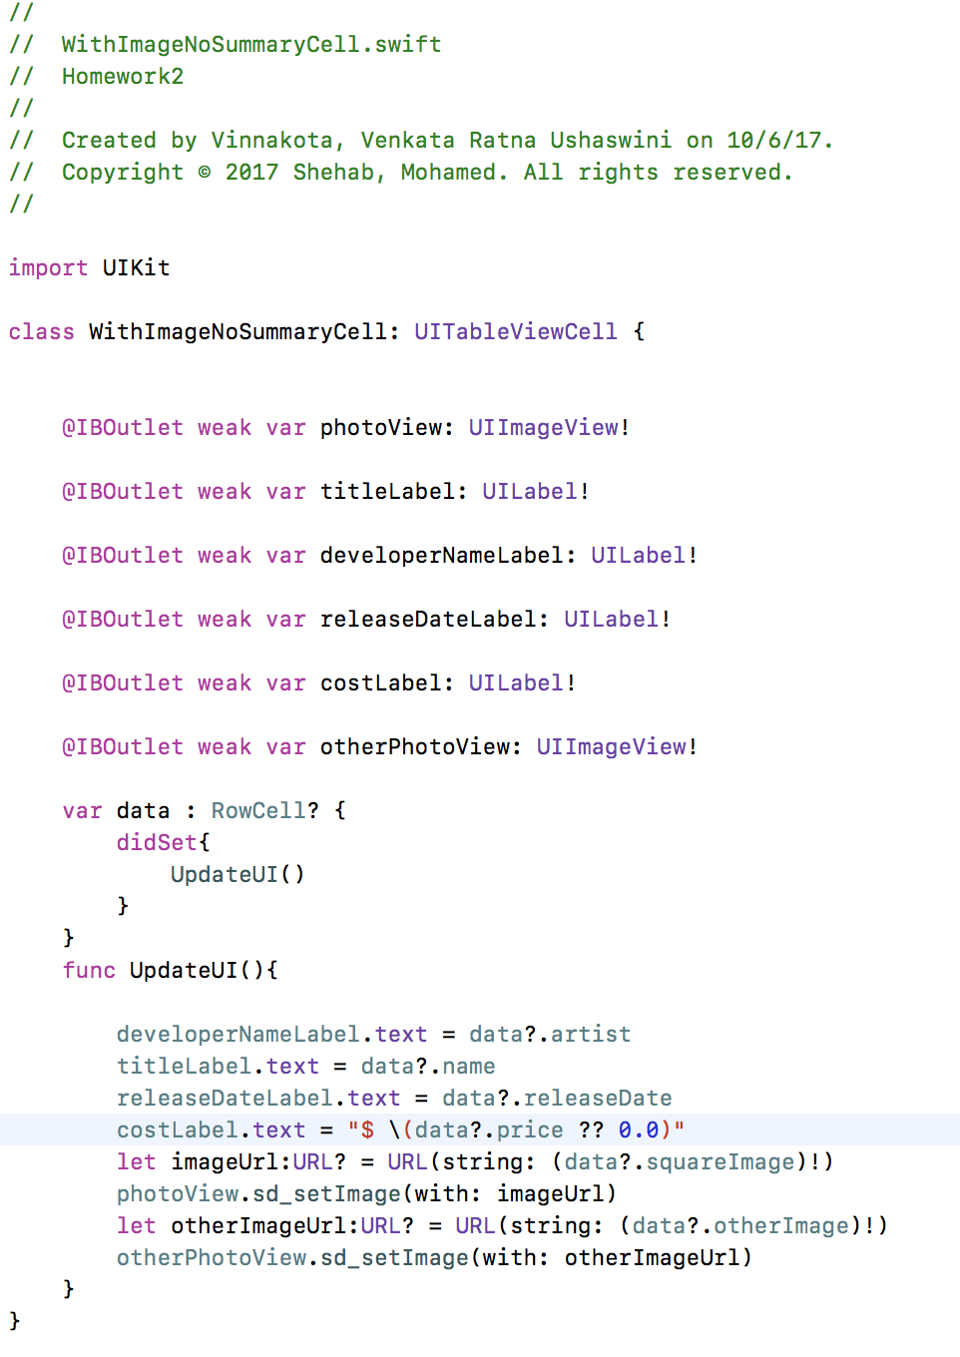
Each prototype cell UI is updated when data property is set!

Slide 5
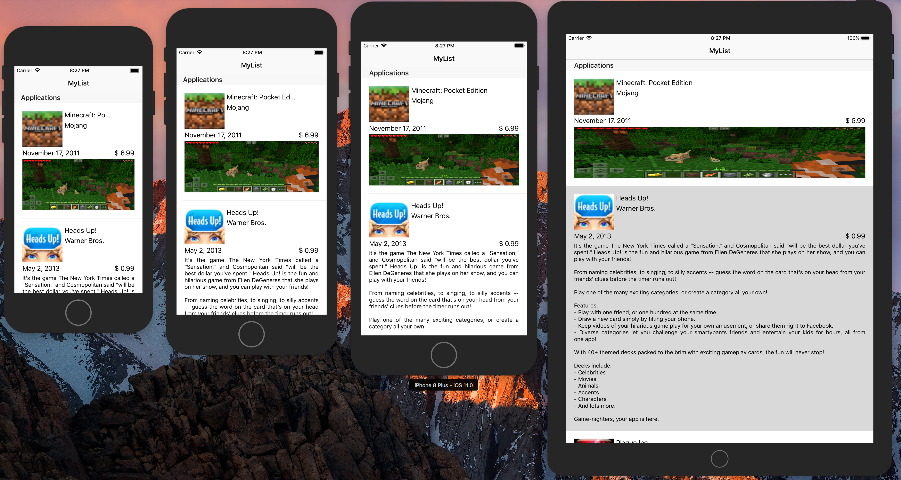
Results
Auto layout is used to scale UI. App is fully functional on any screen size
Output shown in image is on
iPhone 5s,
iPhone6s,
iPhone8Plus and
iPad Air

